Slide 1
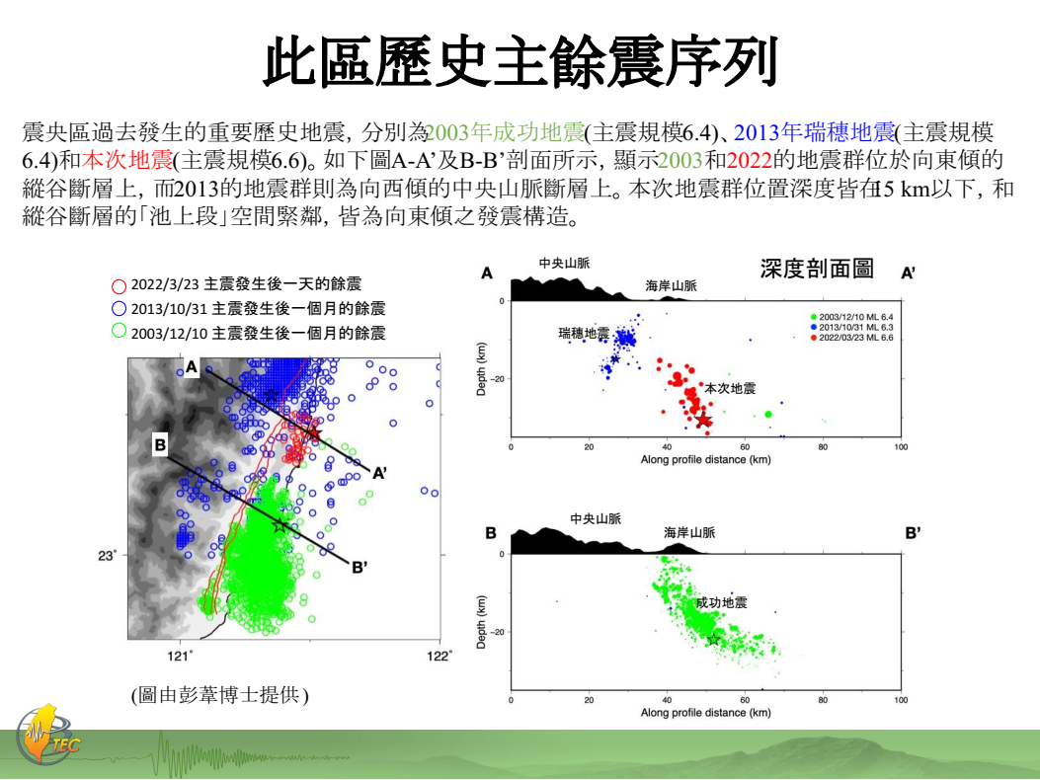
(台灣地震科學中心，2022)

Slide 2
(台灣地震科學中心，2022)
In the directory “EQ20220323”, all files related to 2022-03-23 Yuli Earthquake are inside. Plot the focal mechanisms of mainshock and aftershocks for 2022-03-23 Yuli Earthquake.
Search the focal mechanisms for 2003 Chengkung earthquake and 2013 Juisui Earthquake, and plot them with Yuil Earthquke. (You must plot them in proper symbol to distinguish them.)
Plot the profile for 2022-03-23 Yuli Earthquake.

Slide 3
資料說明
EQ_catalog: 1990~2021 earthquake catalog from CWB
EQ20220323_large: sensible earthquakes for 20220323 event
EQ20220323_small: regional records for 20220323 event
EQ20220323_meca_sa: Realtime focal mechnisms for 20220323 event

